Slide 1
Tecnix Data Logger, Server and Webpage
Team 3: Isabel Woelke, Artan Tagani, Ryan Doyle, Devin Abb, Davis Brown, Shadman Chowdhury
Sponsor: Erik Tarkleson of Tecnix
Facilitator: Dr. Mahapatra

Slide 2
Introduction
Tecnix: locally produced, residential wind turbines
Task: produce an accurate data logger that stores data in a database and projects data analysis on a web server in an easy-to-understand manner

Slide 3
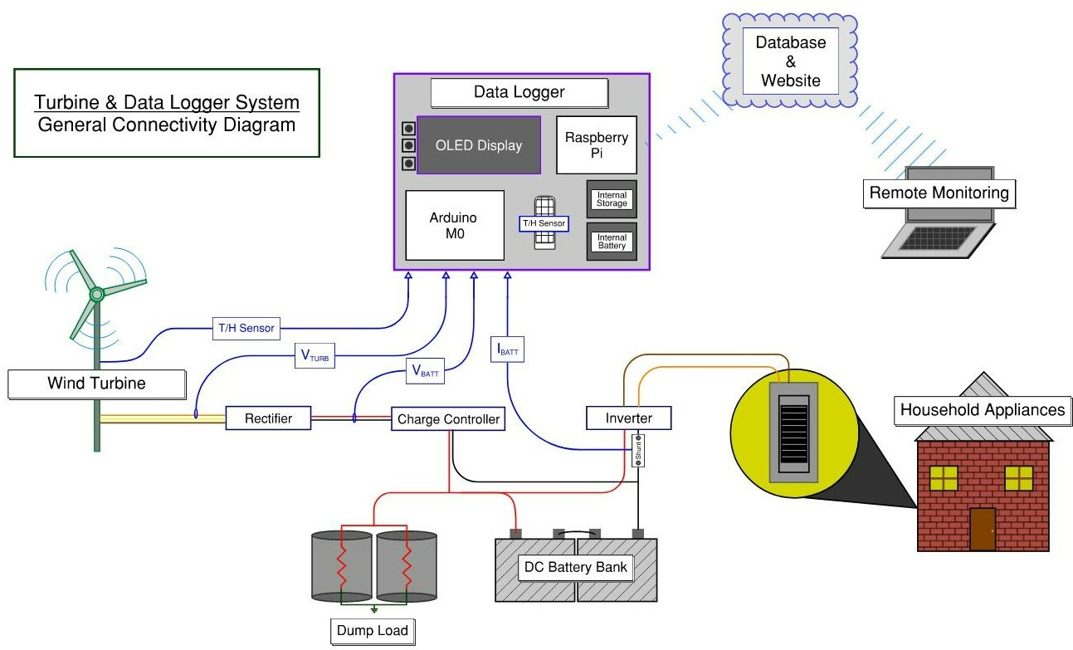
System Diagram

Slide 4

Demonstration Video

Slide 5
Overall End-Goals/Deliverables
Measure accurate voltage/current measurements and store in logs
Add a new sensor for temperature & humidity
Implement a database to store daily measurements in
Create a website to display the data in a graphical/user-friendly way
Combine all components together

Slide 6
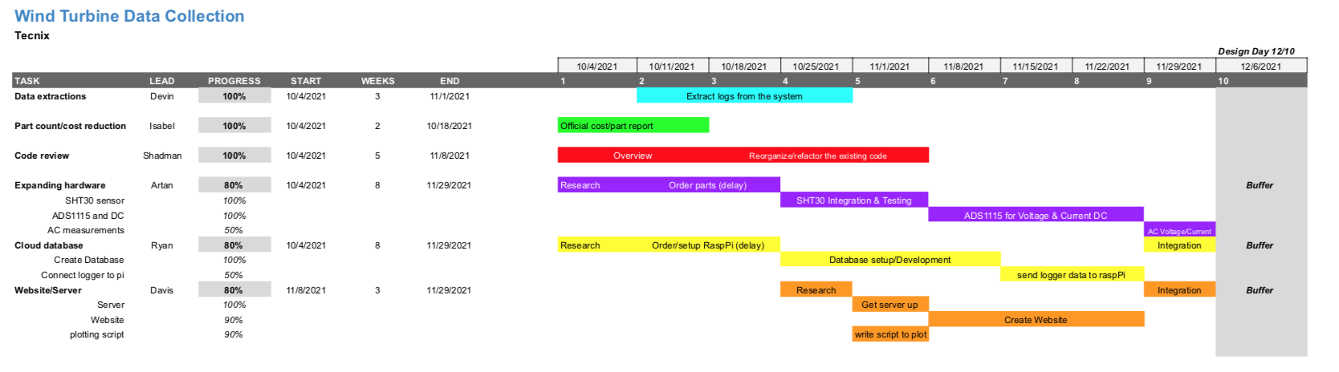
Gantt Chart

Slide 7
Budget
ITEM | COST | DESCRIPTION
Raspberry Pi Pico RP2040 | $4.00 | Raspberry Pi with two I2C controllers, two SPI controllers and two UARTs.
SHT30 Temperature And Humidity Sensor - Wired Enclosed Shell | $8.95 | Temperature/Humidity sensor with ±2% humidity and ±0.5° celsius with I2C UI
AM2315 - Encased I2C Temperature/Humidity Sensor | $29.95 | Thermistor temperature sensor along with a humidity sensor with an I2C UI
Adalogger Featherwing & Battery | $9.90 | Allows data to be stored onto a micro SD and has an I2C real time clock

Slide 8
Budget
ITEM | COST | DESCRIPTION
128x64 OLED Display | $14.95 | Displays the information on the data logger
Panel Volt Meter | $7.95 | Reads the DC voltage
Ethernet Featherwing | $19.95 | Expands to allow for an ethernet connection port
Featherwing Tripler | $8.50 | Add-on for Featherwing board that allows connecting multiple Featherwing without stacking headers
Featherwing Single Proto | $4.95 | Add-on for the Featherwing board to duplicate pins

Slide 9
Budget
ITEM | COST | DESCRIPTION
10’ Ethernet Cable | $2.95 | Ethernet cable to connect to Ethernet FeatherBoard
Raspberry Pi Zero WH (Zero W with Headers) | $14.00 | Raspberry Pi to host a web server. (More powerful than Pico)
4 Channel 16 Bit ADC Converter | $14.95 | Converts up to 4 analog signals to digital sent via I2C
TOTAL: | $174.61
One goal of the project is to keep the data logger cost as low as possible
Compared to the overall cost to install one of Tecnix’s wind turbine system, this is reasonable and for a good cause

Slide 10
Next Steps
Implement the AC current sensor
Calculate the power factor
Combine components into single PCB
Connect the Adafruit M0 to the RasPi
Send data from database to website

Slide 11
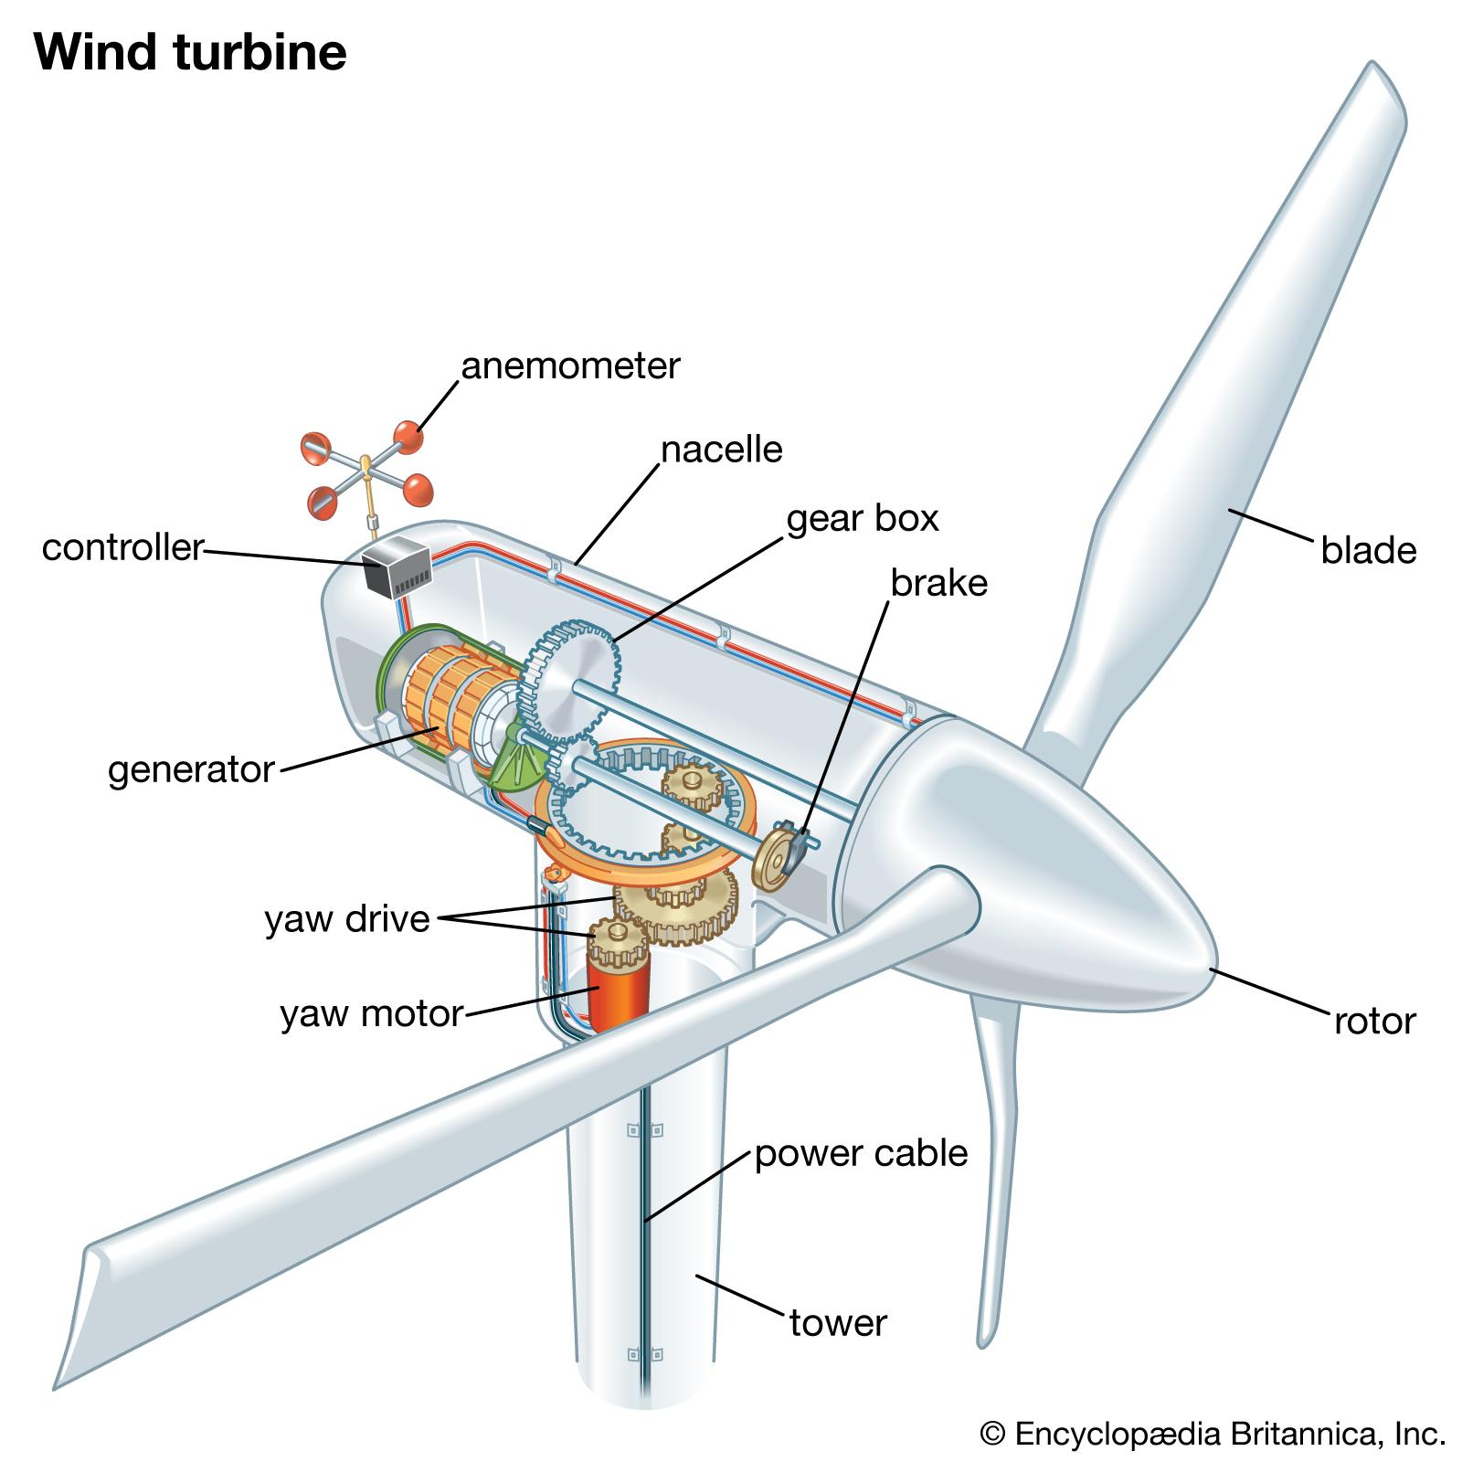
Questions

